Slide 1

Database Principles:
Fundamentals of Design, Implementation, and Management
Tenth Edition
Chapter 4
Relational Model Characteristics

Slide 2
Objectives
In this chapter, students will learn:
That the relational database model offers a logical view of data
About the relational model’s basic component: relations
That relations are logical constructs composed of rows (tuples) and columns (attributes)
That relations are implemented as tables in a relational DBMS

Slide 3
Objectives (cont’d.)
About relational database operators, the data dictionary, and the system catalog
How data redundancy is handled in the relational database model
Why indexing is important

Slide 4
A Logical View of Data
Relational model
  View data logically rather than physically
Table
  Structural and data independence
  Resembles a file conceptually
Relational database model is easier to understand than hierarchical and network models

Slide 5
Tables and Their Characteristics
Logical view of relational database is based on relation
  Relation thought of as a table
Table: two-dimensional structure composed of rows and columns
  Persistent representation of logical relation
Contains group of related entities (entity set)

Slide 6
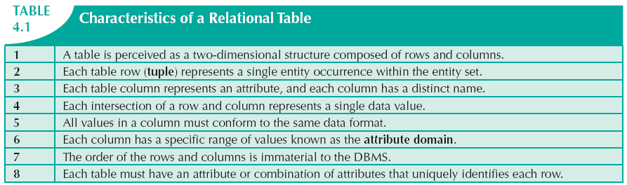

Slide 7
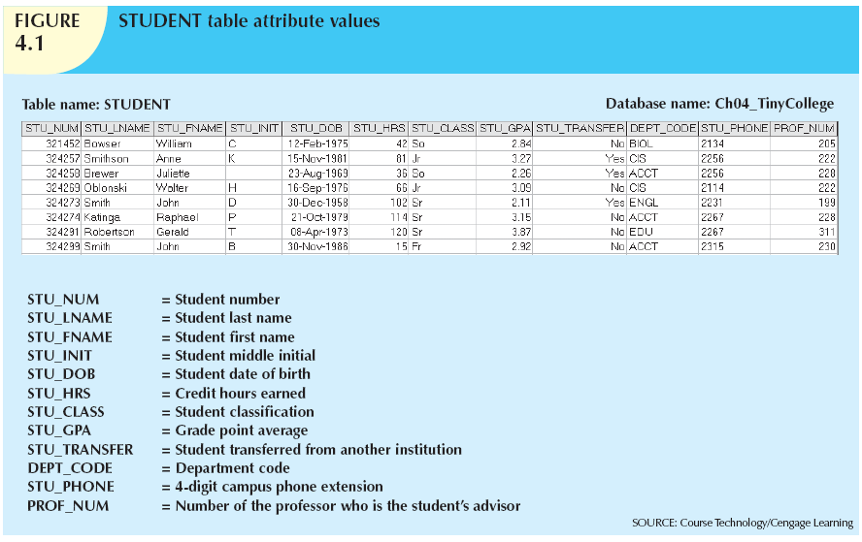

Slide 8
Keys
Each row in a table must be uniquely identifiable
Key: one or more attributes that determine other attributes
  Key’s role is based on determination
    If you know the value of attribute A, you can determine the value of attribute B
  Functional dependence
    Attribute B is functionally dependent on A if all rows in table that agree in value for A also agree in value for B

Slide 9
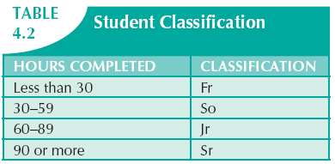

Slide 10
Types of Keys
Composite key
  Composed of more than one attribute
Key attribute
  Any attribute that is part of a key
Superkey
  Any key that uniquely identifies each row
Candidate key
  A superkey without unnecessary attributes

Slide 11
Types of Keys (cont’d.)
Entity integrity
  Each row (entity instance) in the table has its own unique identity
Nulls
  No data entry
  Not permitted in primary key
  Should be avoided in other attributes

Slide 12
Types of Keys (cont’d.)
  Can represent:
    An unknown attribute value
    A known, but missing, attribute value
    A “not applicable” condition
  Can create problems when functions such as COUNT, AVERAGE, and SUM are used
  Can create logical problems when relational tables are linked

Slide 13
Types of Keys (cont’d.)
Controlled redundancy
  Makes the relational database work
  Tables within the database share common attributes
    Enables tables to be linked together
  Multiple occurrences of values not redundant when required to make the relationship work
  Redundancy exists only when there is unnecessary duplication of attribute values

Slide 14
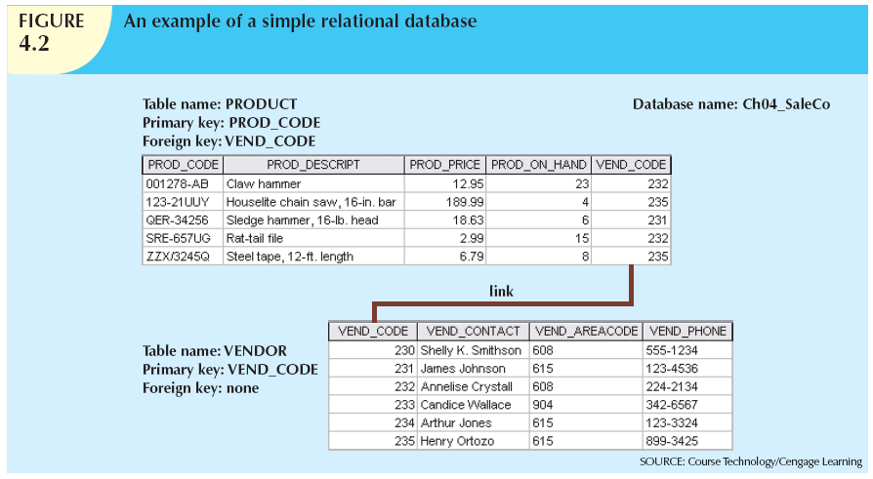

Slide 15
Types of Keys (cont’d.)
Foreign key (FK)
  An attribute whose values match primary key values in the related table
Referential integrity
  FK contains a value that refers to an existing valid tuple (row) in another relation
Secondary key
  Key used strictly for data retrieval purposes

Slide 16
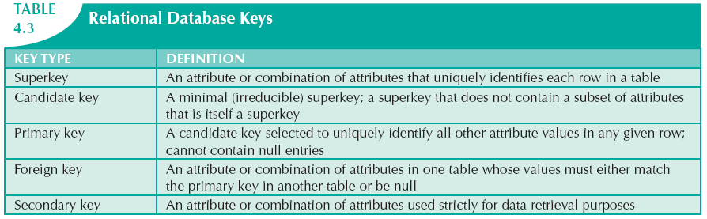

Slide 17
Integrity Rules
Many RDBMs enforce integrity rules automatically
Safer to ensure that application design conforms to entity and referential integrity rules
Designers use flags to avoid nulls
  Flags indicate absence of some value

Slide 18
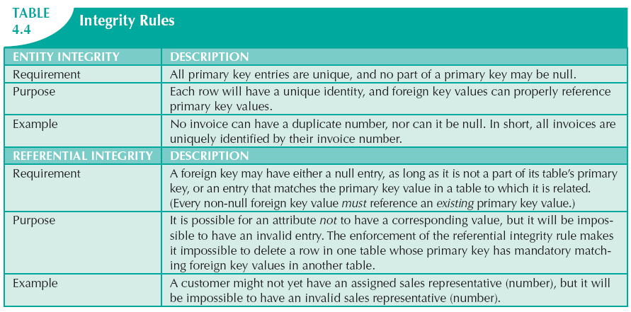
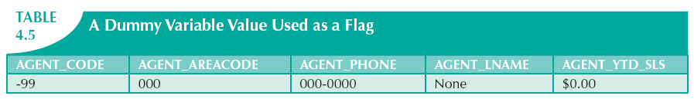

Slide 19
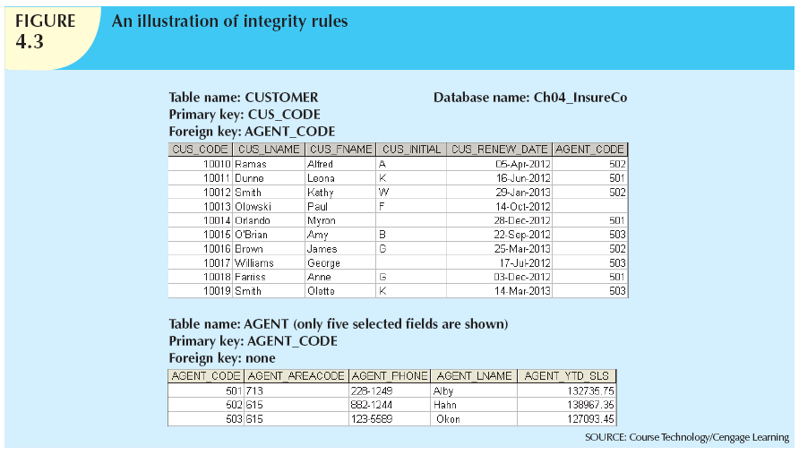

Slide 20
Relational Set Operators
Relational algebra
  Defines theoretical way of manipulating table contents using relational operators
  Use of relational algebra operators on existing relations produces new relations:
SELECT | UNION
PROJECT | DIFFERENCE
JOIN | PRODUCT
INTERSECT | DIVIDE

Slide 21
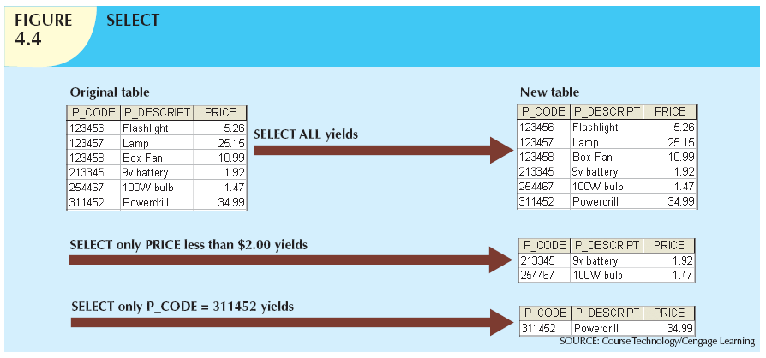

Slide 22
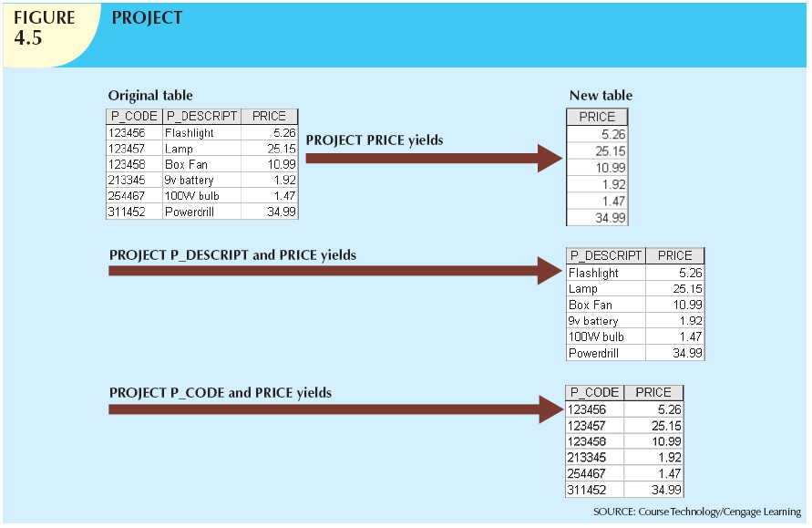

Slide 23
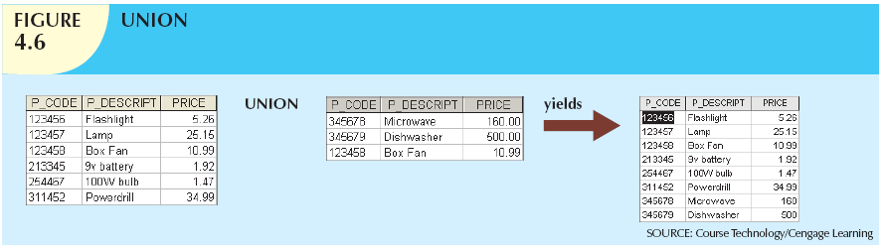
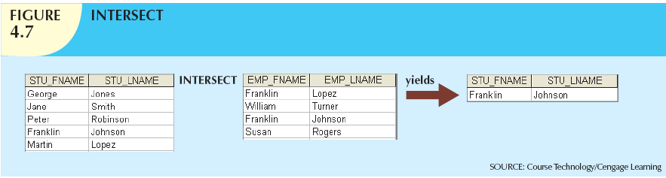

Slide 24
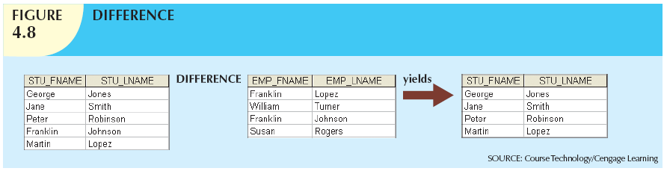
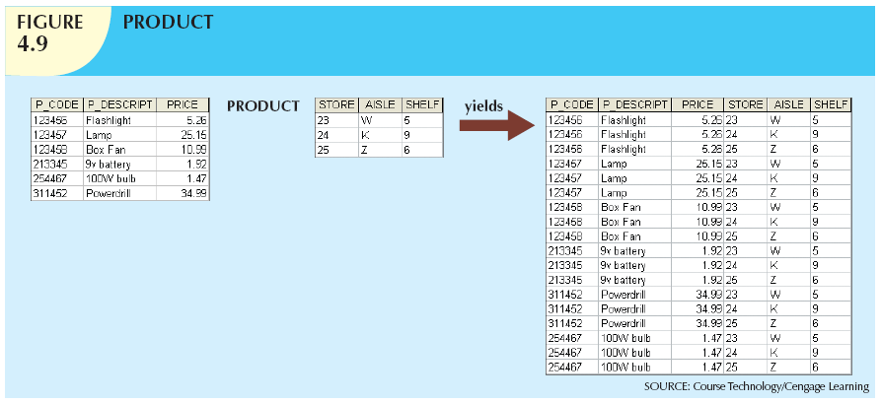

Slide 25
Relational Set Operators (cont’d.)
Natural join
  Links tables by selecting rows with common values in common attributes (join columns)
Equijoin
  Links tables on the basis of an equality condition that compares specified columns
Theta join
  Any other comparison operator is used

Slide 26
Relational Set Operators (cont’d.)
Inner join
  Only returns matched records from the tables that are being joined
Outer join
  Matched pairs are retained, and any unmatched values in other table are left null

Slide 27
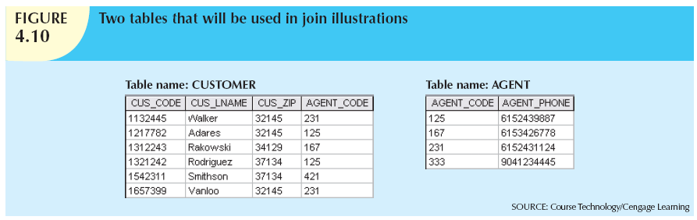

Slide 28
Relational Set Operators (cont’d.)
Left outer join
  Yields all of the rows in the CUSTOMER table
  Including those that do not have a matching value in the AGENT table
Right outer join
  Yields all of the rows in the AGENT table
  Including those that do not have matching values in the CUSTOMER table

Slide 29
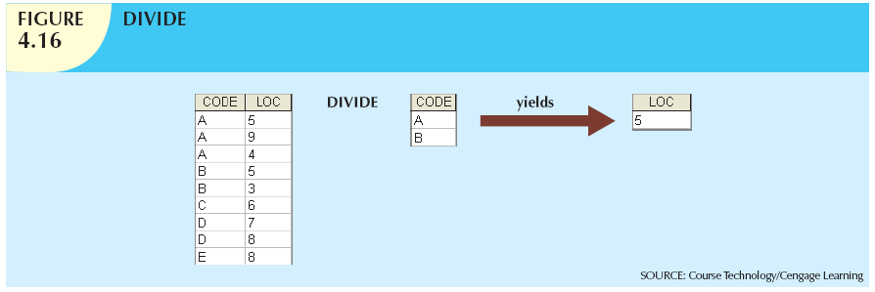

Slide 30
The Data Dictionary and System Catalog
Data dictionary
  Provides detailed accounting of all tables found within the user/designer-created database
  Contains (at least) all the attribute names and characteristics for each table in the system
  Contains metadata: data about data
System catalog
  Contains metadata
  Detailed system data dictionary that describes all objects within the database

Slide 31
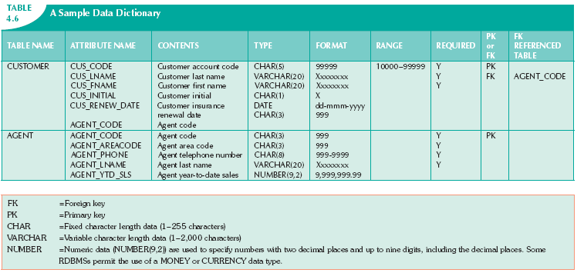

Slide 32
The Data Dictionary and System Catalog (cont’d.)
Homonym
  Indicates the use of the same name to label different attributes
Synonym
  Opposite of a homonym
  Indicates the use of different names to describe the same attribute

Slide 33
Relationships within the Relational Database
1:M relationship
  Relational modeling ideal
  Should be the norm in any relational database design
1:1 relationship
  Should be rare in any relational database design

Slide 34
Relationships within the Relational Database (cont’d.)
M:N relationships
  Cannot be implemented as such in the relational model
  M:N relationships can be changed into 1:M relationships

Slide 35
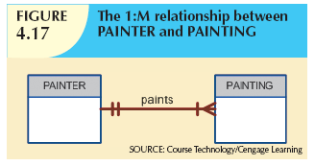
The 1:M Relationship
Relational database norm
Found in any database environment

Slide 36
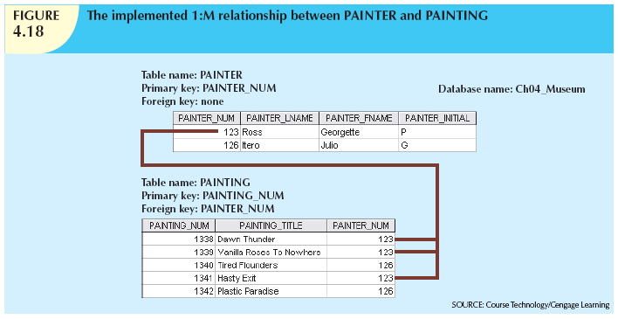

Slide 37
The 1:1 Relationship
One entity related to only one other entity, and vice versa
Sometimes means that entity components were not defined properly
Could indicate that two entities actually belong in the same table
Certain conditions absolutely require their use

Slide 38
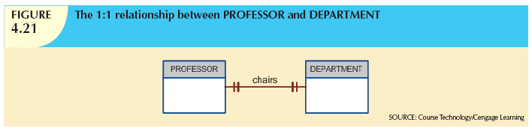

Slide 39
The M:N Relationship
Implemented by breaking it up to produce a set of 1:M relationships
Avoid problems inherent to M:N relationship by creating a composite entity
  Includes as foreign keys the primary keys of tables to be linked

Slide 40
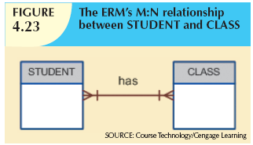

Slide 41
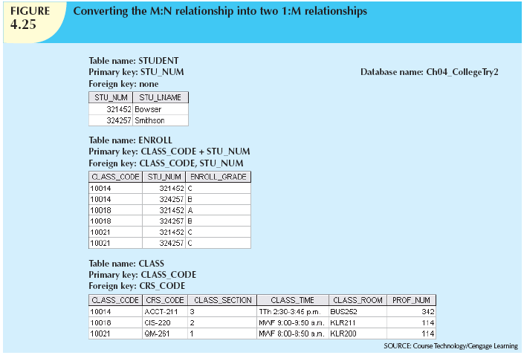

Slide 42
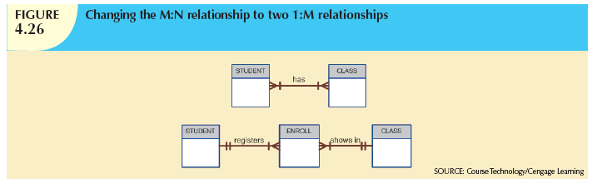

Slide 43
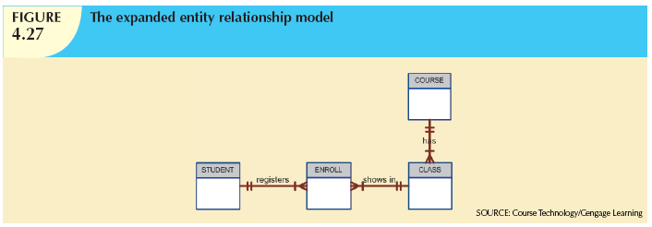

Slide 44
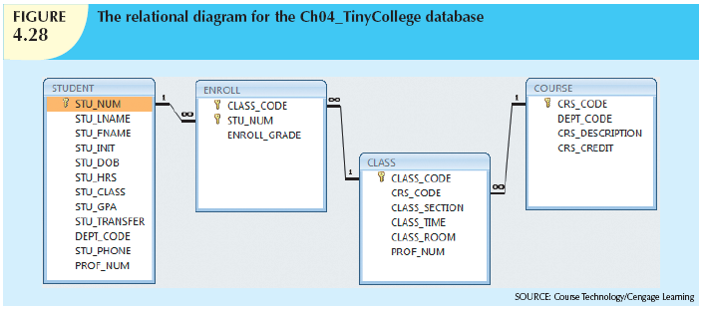

Slide 45
Data Redundancy Revisited
Data redundancy leads to data anomalies
  Can destroy the effectiveness of the database
Foreign keys
  Control data redundancies by using common attributes shared by tables
  Crucial to exercising data redundancy control
Sometimes, data redundancy is necessary

Slide 46
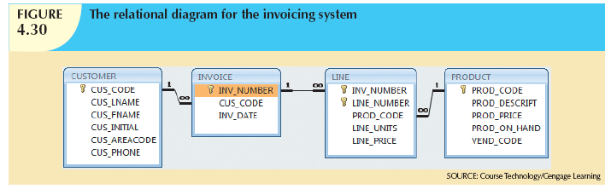

Slide 47
Indexes
Orderly arrangement to logically access rows in a table
Index key
  Index’s reference point
  Points to data location identified by the key
Unique index
  Index in which the index key can have only one pointer value (row) associated with it
Each index is associated with only one table

Slide 48
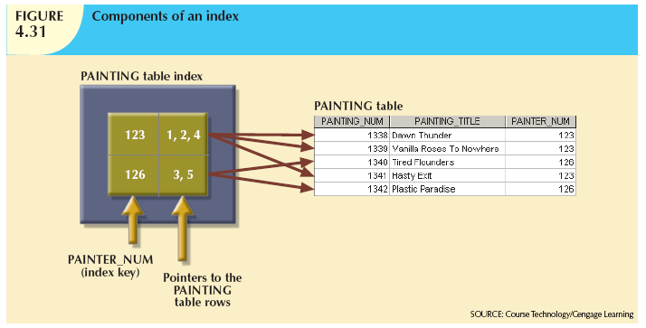

Slide 49
Codd’s Relational Database Rules
In 1985, Codd published a list of 12 rules to define a relational database system
  Products marketed as “relational” that did not meet minimum relational standards
Even dominant database vendors do not fully support all 12 rules

Slide 50
Summary
Tables are basic building blocks of a relational database
Keys are central to the use of relational tables
Keys define functional dependencies
  Superkey
  Candidate key
  Primary key
  Secondary key
  Foreign key

Slide 51
Summary (cont’d.)
Each table row must have a primary key that uniquely identifies all attributes
Tables are linked by common attributes
The relational model supports relational algebra functions
  SELECT, PROJECT, JOIN, INTERSECT UNION, DIFFERENCE, PRODUCT, DIVIDE
Good design begins by identifying entities, attributes, and relationships
  1:1, 1:M, M:N

